Slide 1

Hydration Intelligence
Leveraging Machine Learning & Power BI for Predictive Wellness Analytics

Slide 2

The Hydration Deficit
Why Track Hydration?
Maintaining optimal hydration is critical for overall health, cognitive function, and sustained physical performance.
Despite its importance, over 70% of individuals suffer from chronic, mild dehydration, leading to fatigue, decreased focus, and long-term health risks.
Our solution bridges the gap between daily habits and proactive health management through predictive intelligence.

Slide 3








Project Ecosystem
Streamlit Interface
Scikit-Learn ML
Power BI Dashboards
A fast, responsive web application that captures user inputs in real-time, providing immediate, personalized hydration assessments.
The predictive engine. A robust Random Forest classification pipeline that analyzes physiological and environmental data.
Aggregated visual analytics that allow organizations to track macro hydration trends across demographics and locations.

Slide 4


The Data Foundations
Numerical Features
Categorical Features
Quantitative metrics forming the baseline of an individual's physical profile and intake habits:
Qualitative factors that significantly alter hydration demands based on external variables:
Age: Impacts baseline metabolic requirements.
Gender: Influences body composition and baseline requirements.
Weight (kg): Directly correlates with baseline fluid volume needs.
Physical Activity Level: Determines fluid loss through exertion and sweat.
Daily Water Intake (L): The primary behavioral metric being evaluated.
Weather: Environmental heat/humidity dictating evaporation rates.

Slide 5


Exploratory Data Analysis
Uncovering Hidden Patterns
Before training the model, we performed a thorough Exploratory Data Analysis (EDA) to understand feature relationships.
Correlation heatmaps revealed strong mathematical links between 'Physical Activity Level', 'Weather' conditions, and the required 'Daily Water Intake'.
These insights confirmed that standardizing numerical variables and effectively encoding categorical data would be crucial for model accuracy.

Slide 6

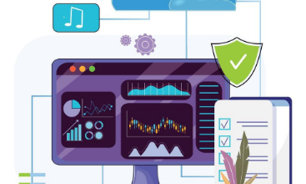



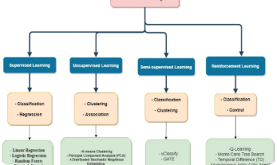
The Machine Learning Pipeline
1. Preprocessing
2. Classification
3. Model Evaluation
Using a `ColumnTransformer`, numerical data is passed through, while categorical data (Gender, Activity, Weather) undergoes One-Hot Encoding to become machine-readable.
The prepared data feeds into a `RandomForestClassifier`. We utilized an ensemble of 100 decision trees to ensure robust, non-linear pattern recognition and prevent overfitting.
Data was split (80% training / 20% testing). The unified Scikit-Learn Pipeline allows seamless end-to-end fitting, scoring high accuracy on unseen test data.

Slide 7
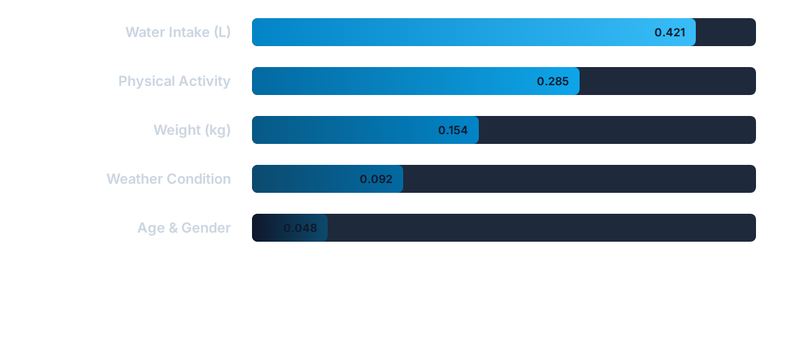
Model Feature Importance
The Random Forest model identified absolute Daily Water Intake and Physical Activity levels as the most critical predictors of maintaining a 'Good' hydration status.

Slide 8


Interactive Front-End
The Streamlit Interface
To make the ML model accessible, we deployed it via a clean, intuitive web application powered by Streamlit.
Users input their daily metrics (age, weight, activity, and consumption) in real-time. The interface instantly passes these parameters to the saved pipeline.
The system returns a definitive "Good" or "Poor" hydration assessment, accompanied by tailored lifestyle and wellness recommendations.

Slide 9

Power BI Integration
Executive Level Dashboards
While the Streamlit app serves the individual, our Power BI integration aggregates predictions to serve organizational intelligence.
These interactive dashboards allow stakeholders to visualize macro trends in hydration sufficiency.
By slicing data across demographics, geographic weather conditions, and physical activity levels, we uncover deeper, actionable business intelligence.

Slide 10
Actionable Recommendations
Consistent Intake Set recurring reminders to consume water throughout the day, rather than drinking large quantities all at once.
Electrolyte Balance For high physical activity levels or extreme heat, plain water is not enough. Replenish sodium and potassium lost through sweat.
Dietary Hydration Incorporate water-rich foods like watermelon, cucumber, and oranges, which can account for up to 20% of daily fluid intake.
Continuous Monitoring Regularly log inputs into the predictive app to track how lifestyle changes (like new workout routines) impact your hydration baseline.

